Slide 1
Introduction to Project Management and Agile Methodology
PrePARED by – Kavitha

Slide 2
What is Project Management
Project management is the process of organizing and managing resources that are necessary to complete a project
Project management, can also be defined as the application of knowledge, skills, tools, and techniques performed within an organization to meet the project requirements
What are Projects
A project is a set of activities performed to meet the creation of a unique product or service
Projects are finite, non repetitive set of activities that has a definite start and end
Projects are customer focused and its main goal is creation of a new product or service

Slide 3
What is Project Management Tool
Assist’s the team to effectively organize work and manage projects and tasks
Features/Benefits of PM Tools
Planning/scheduling - Project management tools allow you to plan and delegate work all in one place with tasks, subtasks, folders, templates, workflows
Collaboration - Project management tools are used to assign tasks, add comments, organize dashboards, and for proofing & approvals
Documentation - Avoid missing files with file management features: editing, versioning, & storage of all files
Evaluation - Track and assess productivity and growth through resource management & reporting

Slide 4
Benefits of Project Management
Clear, organized plans improve team collaboration
Defining everyone’s role eliminates confusion
Well-defined goals improve team effectiveness
Defining a communication plan keeps your team aligned and focused
Project management tools help increase efficiency

Slide 5
What is Agile
Literal meaning of Agile is to able to move quickly and easily
Agile is a collection of principles used in software development and project management
Agile is a project management methodology that uses short development cycles called sprints or iterations to focus on continuous improvement in the development of a product or service
A sprint or iteration is a short, time-boxed period when a team works to complete a set amount of work. A typical sprint is one to four weeks in length

Slide 6
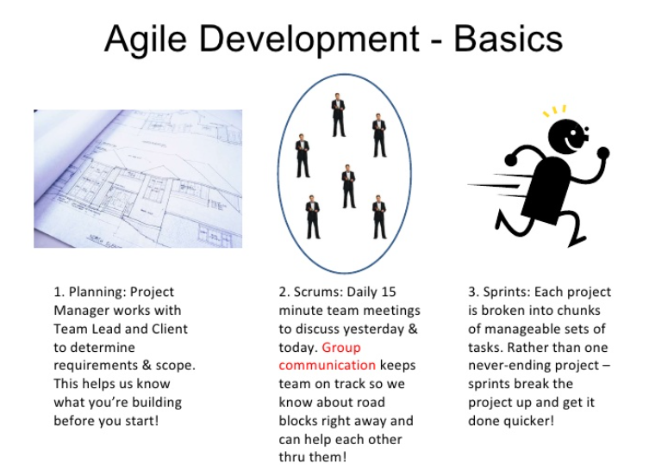

Slide 7
Purpose of Sprint in Agile
The purpose of a sprint is to break down a project to smaller chunks
The team will plan a single sprint at a time and adapt future sprints based on the outcome of the sprints already completed
Each sprint begins with a planning meeting in which the product owner (person requesting the work) and development/research/HR/Social media team agree upon exactly what work will be accomplished during the sprint
At the end of the sprint, the team presents the completed work to the project owner

Slide 8
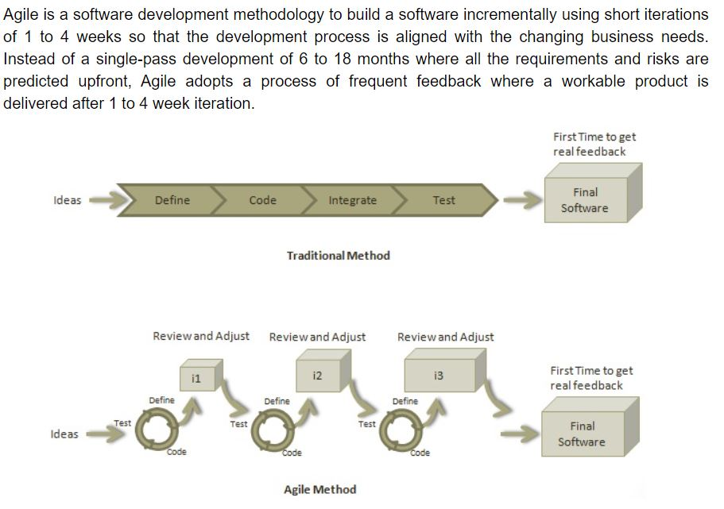

Slide 9
Sprint roles
Product owner: This person represents the business or user community and is a liaison between their team and the customers/stakeholders. The product owner is in charge of defining, prioritizing and adjusting what features will be in the product release.
Scrum master: This person conducts the sprint/standup meetings and manages the process of how information is exchanged during the sprint and helping the team stay on track by mediating problems and removing obstacles.
Scrum team: This group of people is responsible for executing the work. In addition to developers, the scrum team can contain testers, architects, designers. The team is responsible for collectively determining how to reach their goals.
Scrum vs. Sprint
Scrum is the specific, framework used under the Agile umbrella to develop complex products. The term scrum is also used to describe the daily, standup meetings that occur during a sprint.
Sprints are time-boxed periods of one week to one month, during which a product owner, scrum master, and scrum team work to complete a specific product addition. During a sprint, work is done to create new features based on the user stories and backlog. A new sprint starts immediately after the current sprint ends.

Slide 10
Sprint Ceremonies
Sprint workflow and process - The sprint workflow is intended to help team members evaluate their work and communicate with each other throughout the entire process. The workflow is followed for each sprint. The process includes:
Backlog - A list of set tasks that must be completed in each sprint before the product is released. The backlog is built by the product owner. The product owner gives a backlog of prioritized items to the scrum master and scrum team.
Sprint planning - The team discusses top priority tasks/user stories and decides what can be delivered in the sprint.
Sprint backlog - Agreed upon by the entire team, this list finalizes and defines what the team will complete during the sprint.

Slide 11
Sprint – The time frame in which the work must be completed – usually 1 – 4 weeks duration
Daily scrum – Lead by the scrum master, the team comes together for short daily meetings, in which they discuss what they have completed, what they are working on and any issues that are blocking the work.
Outcome - The outcome of a sprint is a hypothetically usable product. The product owner can decide if the product is ready or if additional features are needed.
Sprint end - At the end of a sprint, two meetings are held:
Sprint review – The team shows their work to the product owner.
Sprint retrospective – The team discusses what they can do to improve processes.

